Slide 1
Review-2 on SMS SPAM DETECTION of the Capstone Project
Syed Reshma Banu 2010030165
B. Sravani 2010030544
Under the Guidance of
D.Vinod Kumar
Assistant professor
Computer Science and Engineering Department
KL Hyderabad Off Campus, Aziz Nagar ,Hyderabad

Slide 2
Overview
Introduction
Objectives of the Project
Proposed Methodology/Architecture/Algorithm/Technique/etc
Implementation Details
Results (If any one objective is completed)
References

Slide 3
Introduction
In the modern world where digitization is everywhere, SMS has become one of the most vital forms of communications, unlike other chatting-based messaging systems like Facebook, WhatsApp etc.
Spam can come in various forms, including email spam, SMS spam (text messages), social media spam (spam comments, friend requests, etc.)
Spam detection is essential for protecting users from phishing and malware, saving time by filtering irrelevant messages
SMS spam refers to unsolicited text messages sent to a large number of recipients, often for advertising or phishing purposes. It can include unwanted offers, scams, or attempts to collect sensitive information.
So, to identify those messages Authors have developed a system which will identify such malicious messages and will identify whether or not the message is SPAM or HAM

Slide 4
Objectives of the Project
The objective of the SMS spam detection project is to identify and filter out unwanted spam messages from legitimate ones within the realm of text messaging.
In this project, the goal is to apply, Support Vector Machines (SVM) machine learning algorithm to SMS spam classification problem, compare their performance to gain insight and further explore the problem, and design an application based on one of these algorithms that can filter SMS spams with high accuracy.

Slide 5
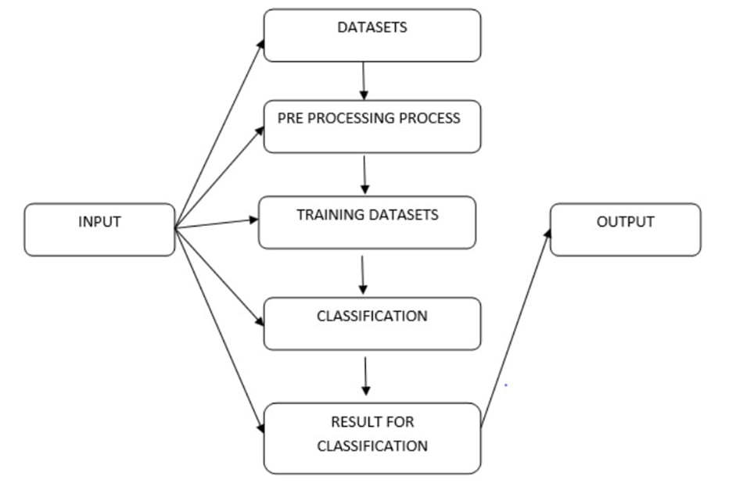
Proposed Methodology/Architecture/Algorithm/Technique/etc

Slide 6
Implementation Details
SVM are strong model for SMS spam detection due to their ease of implementation, interpretability, and good performance on text classification tasks.
Support Vector Machines (SVM) are commonly used in SMS spam detection for their ability to effectively separate and classify text messages as spam or ham. SVM is particularly effective at finding a hyperplane that optimally separates different classes of data. In SMS spam detection, this means SVM can create a decision boundary that effectively separates spam messages

Slide 7
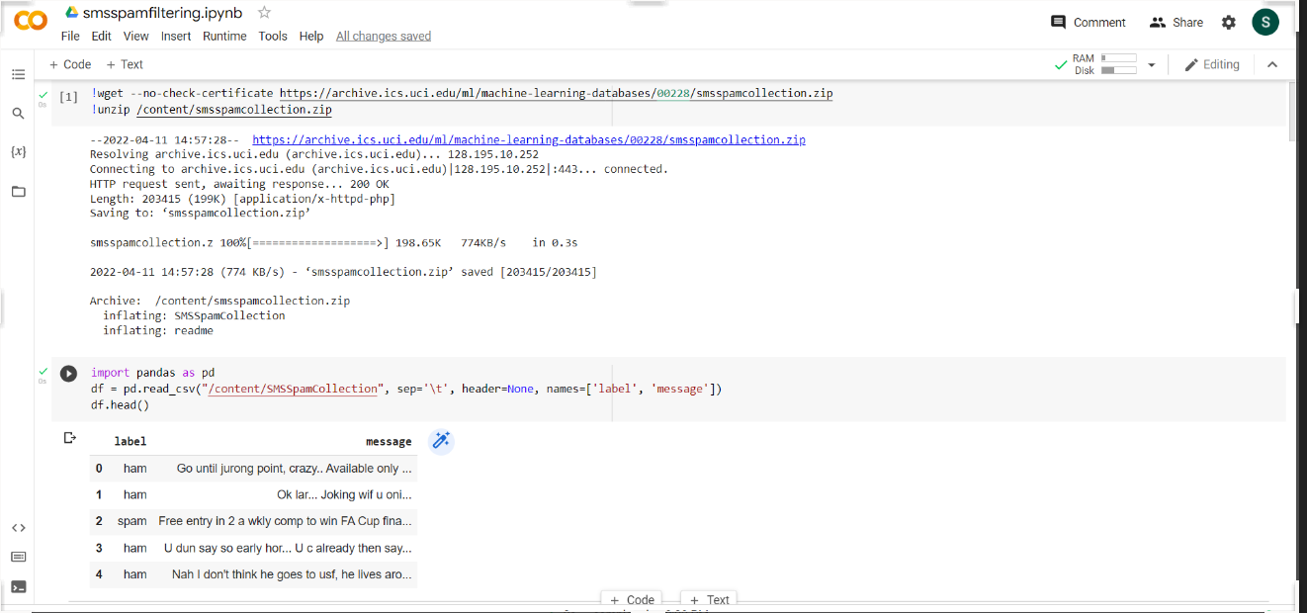
Results

Slide 8
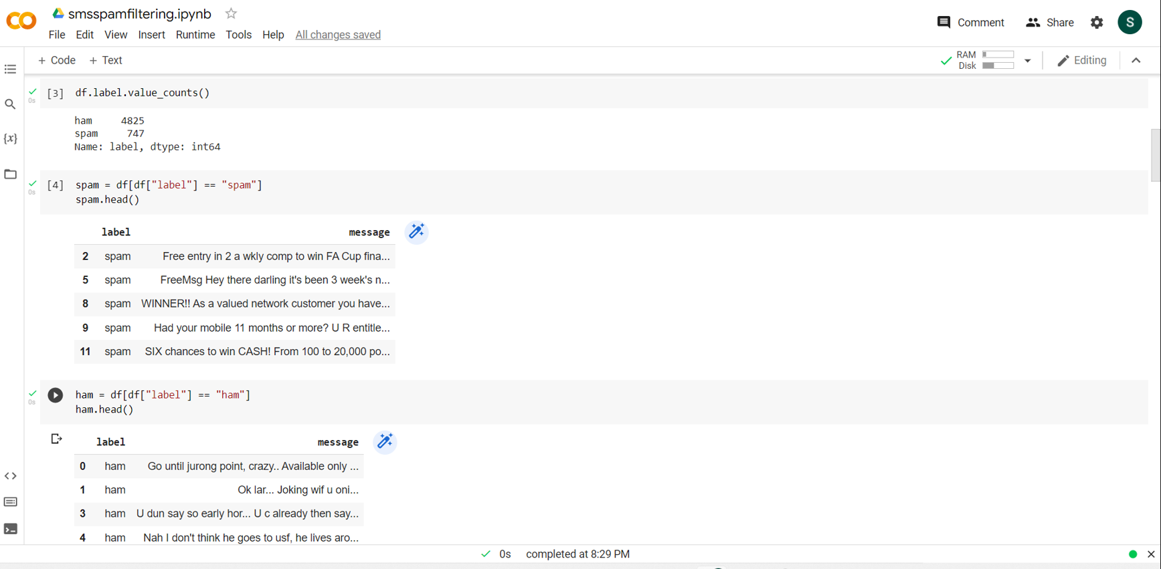

Slide 9
References
List the Research paper titles,or website links,textbooks,
https://www.researchgate.net/publication/349799157_SMS_Spam_Detection_Using_Machine_Learning
https://ieeexplore.ieee.org/abstract/document/8284445
https://cs229.stanford.edu/proj2013/ShiraniMehr-SMSSpamDetectionUsingMachineLearningApproach.pdf

Slide 10
Thank you and Any Queries

